Slide 1
LAB - 07
陳培殷老師
國立成功大學 資訊工程系

Slide 2
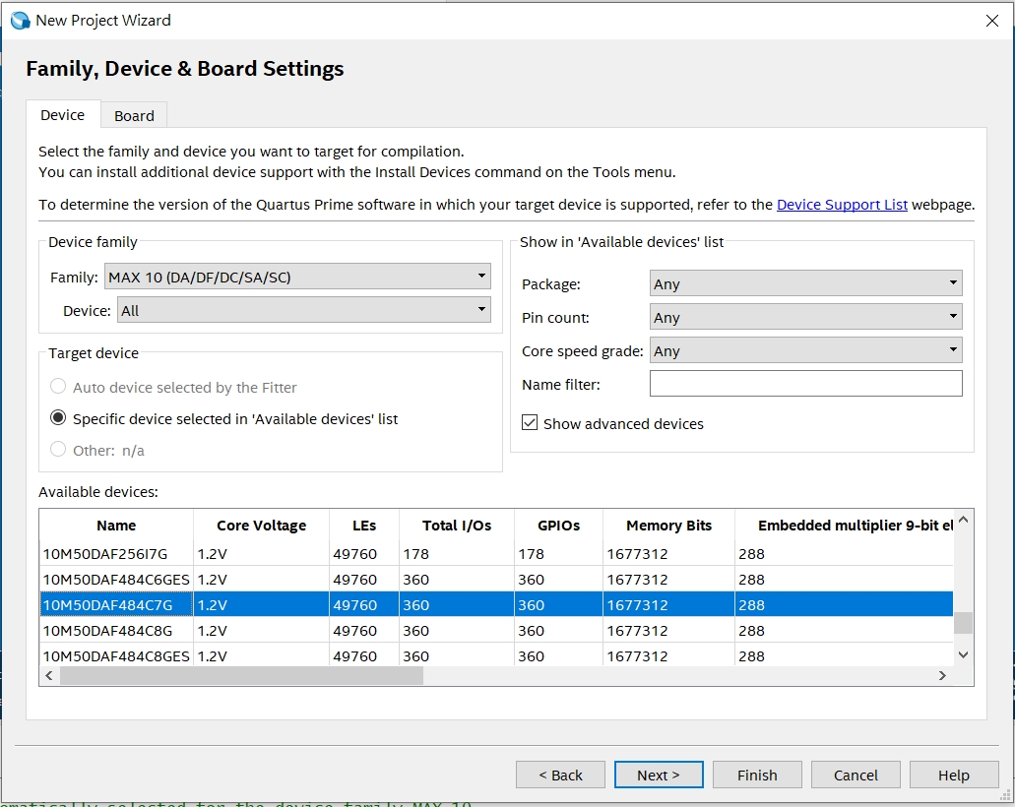
新板子
Specify device settings - (DE10-Lite Device family are used). Click “Next.”
MAX 10(DA/DF/DC/SA/SC)
10M50DAF484C7G

Slide 3
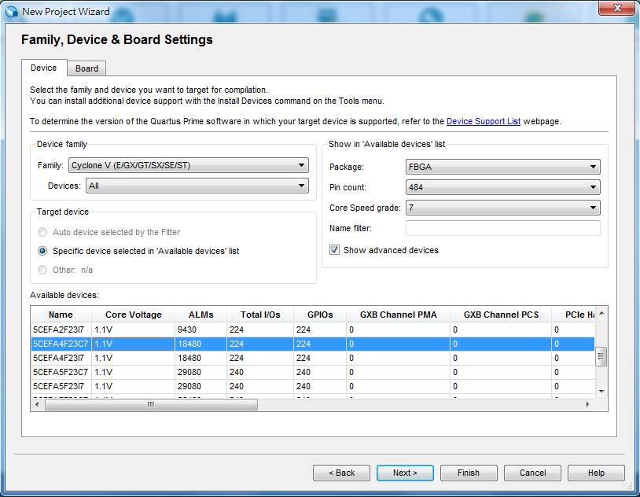
舊板子
Specify device settings - (DE0-CV Device family are used). Click “Next.”
5CEFA4F23C7

Slide 4
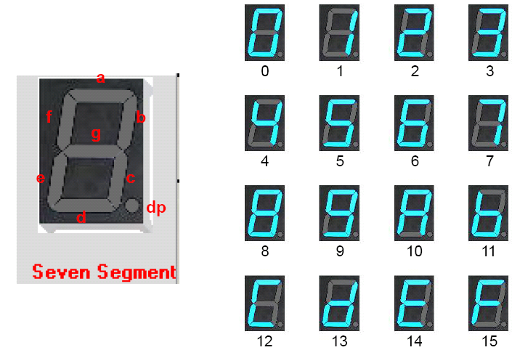
Seven-segment display (1/3)

Slide 5


Seven-segment display (2/3)
0 is on, 1 is off
dp is useless in DE10_Lite board
Ex: out=7'b1000000;
Ex: out=7'b0010010;
g
a
g=1
b=1, e=1

Slide 6
Seven-segment display (3/3) 新板子
Assign out to seven segment digit pin of FPGA
Take seven segment digit 0 as example
Signal Name | FPGA Pin No. | Description | Signal Assigned | 對應字母
HEX00 | PIN_C14 | Seven Segment Digit 0[0] | out[0] | a
HEX01 | PIN_E15 | Seven Segment Digit 0[1] | out[1] | b
HEX02 | PIN_C15 | Seven Segment Digit 0[2] | out[2] | c
HEX03 | PIN_C16 | Seven Segment Digit 0[3] | out[3] | d
HEX04 | PIN_E16 | Seven Segment Digit 0[4] | out[4] | e
HEX05 | PIN_D17 | Seven Segment Digit 0[5] | out[5] | f
HEX06 | PIN_C17 | Seven Segment Digit 0[6] | out[6] | g

Slide 7
Seven-segment display (3/3) 舊板子
Assign out to seven segment digit pin of FPGA
Take seven segment digit 0 as example
Signal Name | FPGA Pin No. | Description | Signal Assigned | 對應字母
HEX00 | PIN_U21 | Seven Segment Digit 0[0] | out[0] | a
HEX01 | PIN_V21 | Seven Segment Digit 0[1] | out[1] | b
HEX02 | PIN_W22 | Seven Segment Digit 0[2] | out[2] | c
HEX03 | PIN_W21 | Seven Segment Digit 0[3] | out[3] | d
HEX04 | PIN_Y22 | Seven Segment Digit 0[4] | out[4] | e
HEX05 | PIN_Y21 | Seven Segment Digit 0[5] | out[5] | f
HEX06 | PIN_AA22 | Seven Segment Digit 0[6] | out[6] | g

Slide 8
Lab I 特殊功能乘法器
設計一個特殊功能乘法器並將結果以七段顯示器表示
功能說明：
當輸入為 0~2，輸出值=輸入值
當輸入為 3~5，輸出值=輸入值乘以 2 後，再加1
當輸入為 6~8，輸出值=輸入值乘以 2 後，再減1
其他輸入，輸出值為 0
輸入為4 bits
輸出為7 bits
SW3~SW0
HEX06~HEX00

Slide 9
Hint
Specialized
Multiplier
4
Seven-Segment
Display
7
input
Calculations
output
Raw numbers to Seven-segments

Slide 10
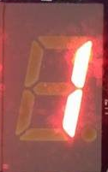
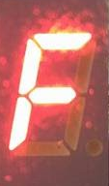
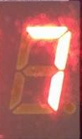
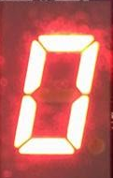
Notice for Lab I
輸入為 0~2
輸出值=輸入值
Ex: in=1, out=1;
當輸入為 3~5
輸出值=輸入值乘以 2 後，再加1
Ex: in=3, out=7;
輸入為 6~8
輸出值=輸入值乘以 2 後，再減1
Ex: in=8, out=15 (F);
其他輸入
輸出值為 0
Ex: in=12, out=0;

Slide 11
Notice
請勿命名中文或數字開頭的資料夾
Device family 請確認與 FPGA Chip 符合 (10M50DAF484C7G)
Top module name & Project name 需要一致
在組合電路中，case、if…else…若沒有寫滿，合成後會產生latch

